Slide 1
Multiple Regression Analysis

Slide 2
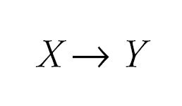
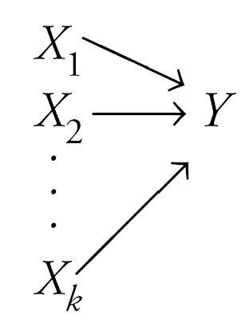
Regression
The idea of regression is to build a model that estimates or predicts one quantitative variable (y) by using at least one other quantitative variable (x).
Simple linear regression uses exactly one x variable to estimate the y variable.
Multiple linear regression, on the other hand, uses more than one x variable to estimate the value of y.

Slide 3
General Multiple Regression Equation Interpretation of coefficients
Now, we use additional independent variables (x₁, x₂ etc) to help better explain the dependent variable
Interpretation of coefficients: Amount which Y changes when that that particular X increases by one unit with the values of all the other independent variables held constant

Slide 4
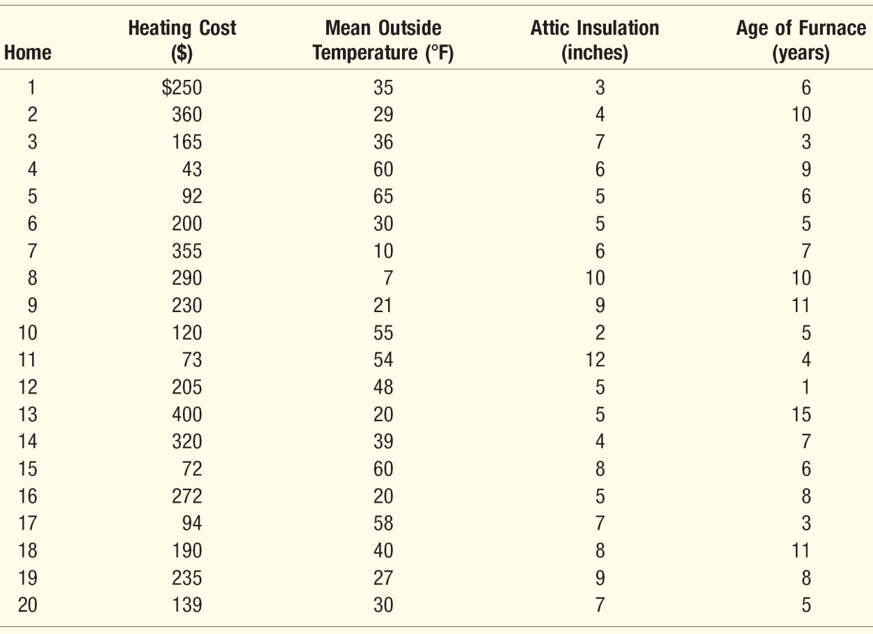
Multiple Linear Regression—Example
An Estate agent sells homes along the east coast of the United States. One of the questions most frequently asked by prospective buyers is: If we purchase this home, how much can we expect to pay to heat it during the winter?
Three variables are thought to relate to the heating costs: (1) the mean daily outside temperature, (2) the number of inches of insulation in the attic, and (3) the age in years of the furnace.
To investigate, the estate agency’s research department selected a random sample of 20 recently sold homes. It determined the cost to heat each home last January, as well
X₁
X₂
X₃

Slide 5
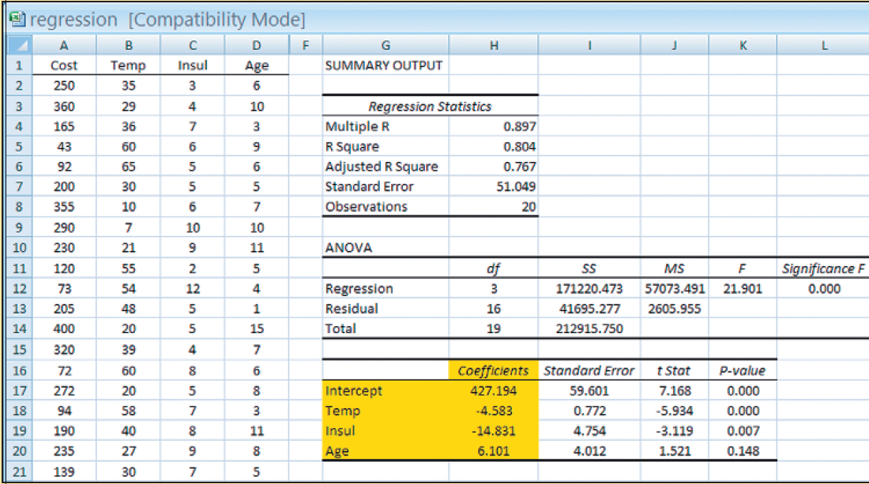
Multiple Linear Regression — EXCEL Output
a
b₁
b₂
b₃

Slide 6
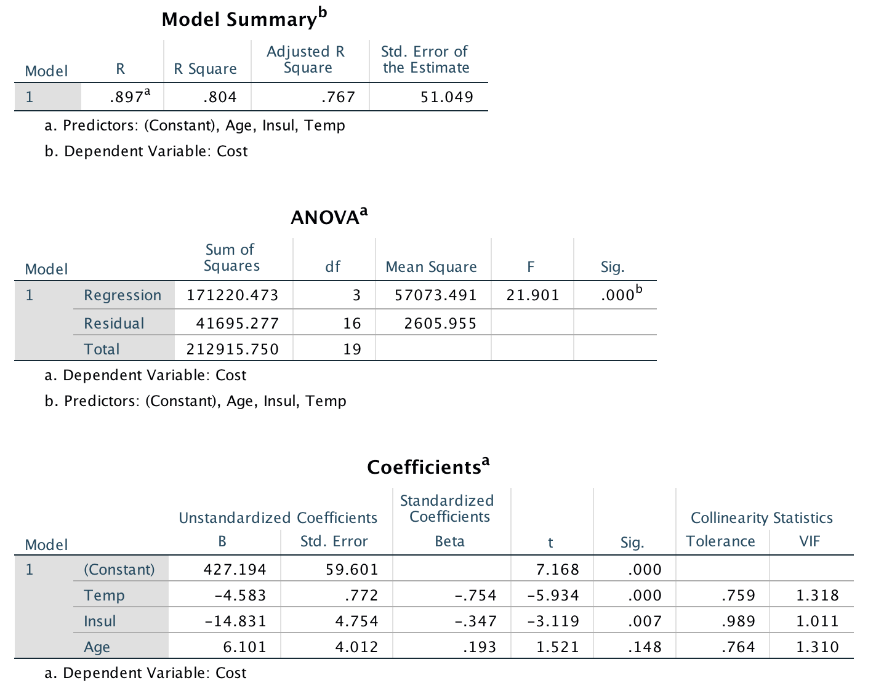
SPSS Output

Slide 7
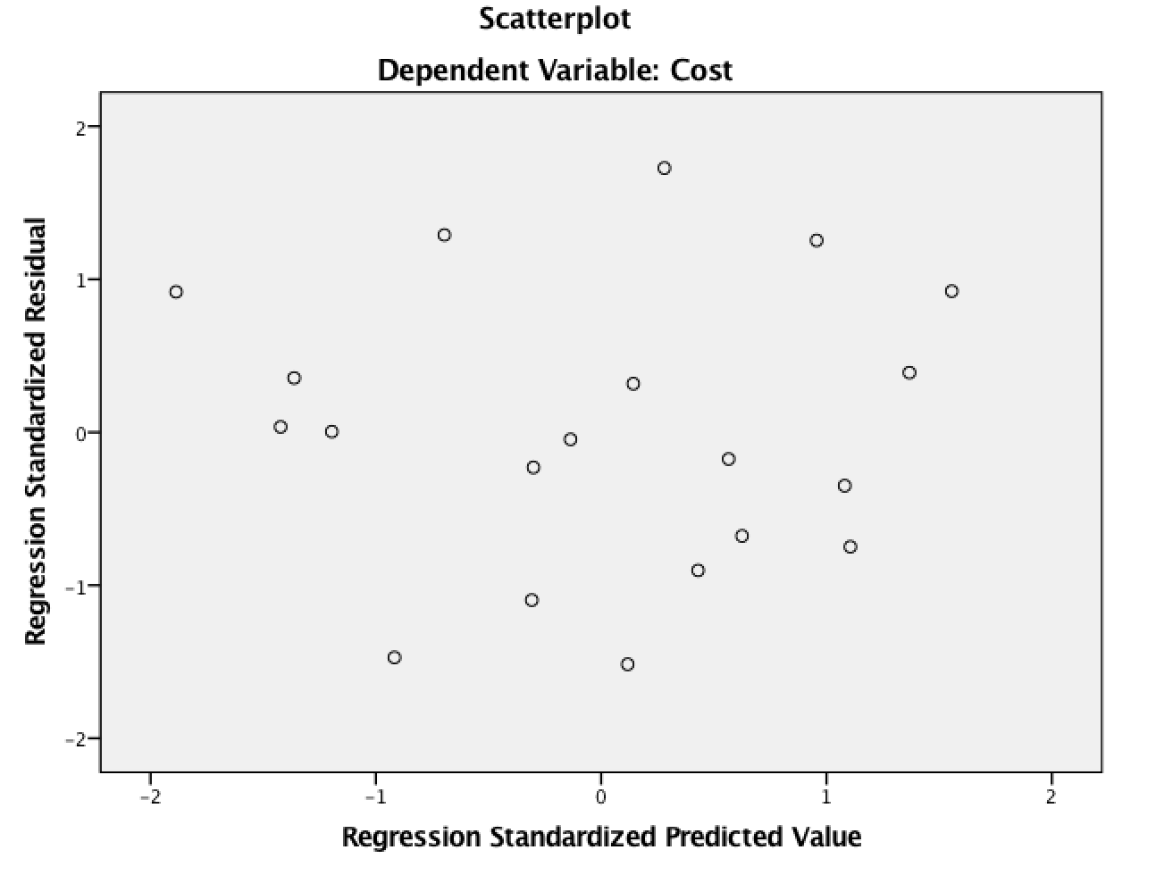
Standardised Residuals Plot

Slide 8
Interpretation of coefficients
In simple linear regression the coefficients represented the slope and y-intercept of the best-fitting line and were straightforward to interpret.
The coefficient of an x variable in a multiple regression model is the amount by which y changes if that x variable increases by one and the values of all other x variables in the model don’t change.
So basically, you’re looking at the marginal contribution of each x variable when you hold the other variables in the model constant.

Slide 9
Interpreting the Measures of Association and Applying the Model for Estimation
Interpreting the Regression Coefficients
Mean Outside Temp, X₁ −4.583
Attic Insulation, X₂ −14.83
Age of Furnace, X₃ +6.10
What is the estimated heating cost for a home if the mean outside temperature is 30 degrees, there are 5 inches of insulation in the attic, and the furnace is 10 years old?

Slide 10
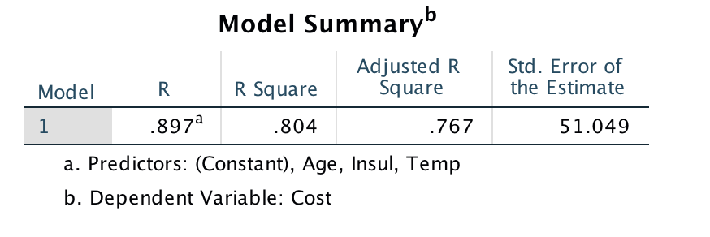
Coefficient of Multiple Determination (R²)
Coefficient of Multiple Determination:
Symbolized by R².
Ranges from 0 to 1.
Cannot assume negative values.
The Adjusted R²:
The number of independent variables in a multiple regression equation makes the coefficient of determination larger.
Adjusted R² is used instead to balance the effect that the number of independent variables has on the coefficient of multiple determination.

Slide 11
Multiple Standard Error of Estimate
The’ typical’ error when we use the equation to predict…
It is measured in the same units as the dependent variable.
It is difficult to determine what is a large value and what is a small value of the standard error.

Slide 12
Introducing a ‘Dummy Variable’
Nominal-scale variables—such as gender, ethic background—can be included in model. These are called qualitative variables.
Use dummy variables in which one of the two possible conditions is coded 0 and the other 1.
EXAMPLE
Suppose in the Estate Agency example that the independent variable “garage” is added. For those homes without an attached garage, 0 is used; for homes with an attached garage, a 1 is used.

Slide 13
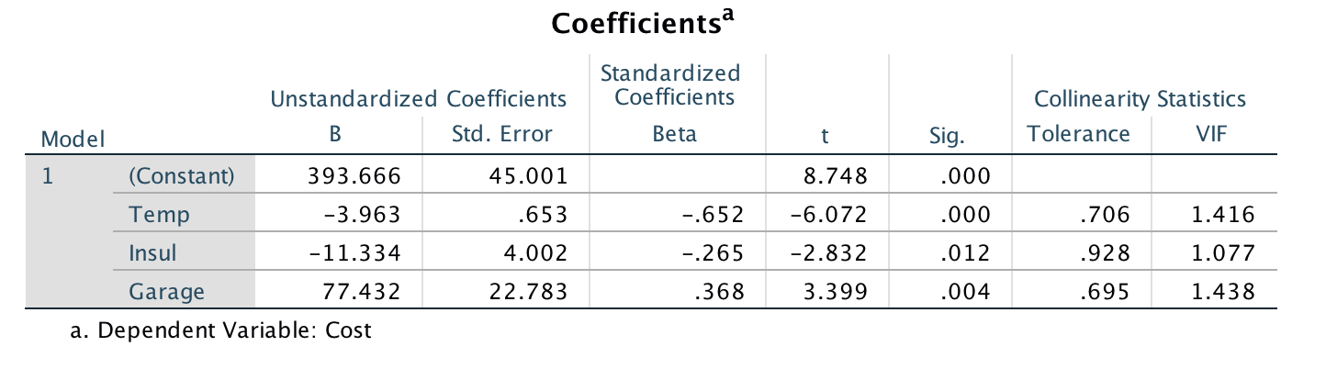

Slide 14
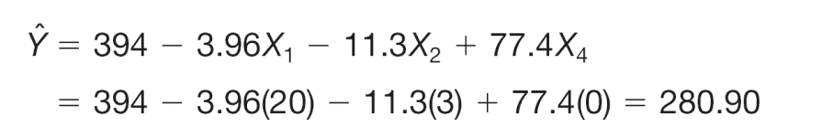
Interpreting the coefficient of the Dummy Variable
What is the effect of the garage variable? Suppose we have two houses exactly alike next to each other; one has an attached garage, and the other does not. Both homes have 3 inches of insulation, and the mean January temperature in the area is 20 degrees.
For the house without an attached garage, a 0 is substituted for in the regression equation. The estimated heating cost is $280.90, found by:
For the house with an attached garage, a 1 is substituted for in the regression equation. The estimated heating cost is $358.30, found by:
Without garage
With garage

Slide 15
Global Test: Testing the Multiple Regression Model
The global test is used to investigate whether any of the independent variables have significant coefficients.
The hypotheses are:

Slide 16
Multiple Regression Analysis
Example 2

Slide 17
Album Sales Example (see Field, A., Discovering statistics 4e)
A record company boss was interested in predicting album sales from advertising.
Data
200 different album releases
Outcome variable:
Sales (CDs and Downloads) in the week after release
Predictor variables
The amount (in £s) spent promoting the album before release (see simple linear regression)
Number of plays on the radio (new variable)

Slide 18
Multiple Regression as an Equation
With multiple regression the relationship is described using a variation of the equation of a straight line.
b₀ is the intercept.
b₁ is the regression coefficient for variable 1.
b₂ is the regression coefficient for variable 2.
b_{n} is the regression coefficient for n^{th} variable.

Slide 19
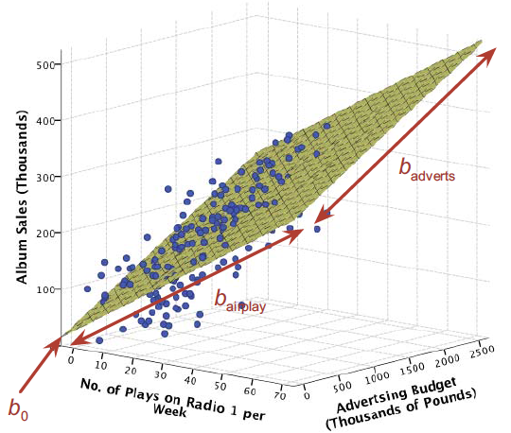
The Model for Example 2 with Two Predictors

Slide 20
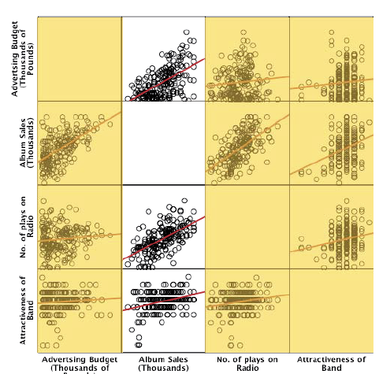
Checking for Linearity
Look at some scatterplots of the relationships between the outcome variable and the predictors

Slide 21
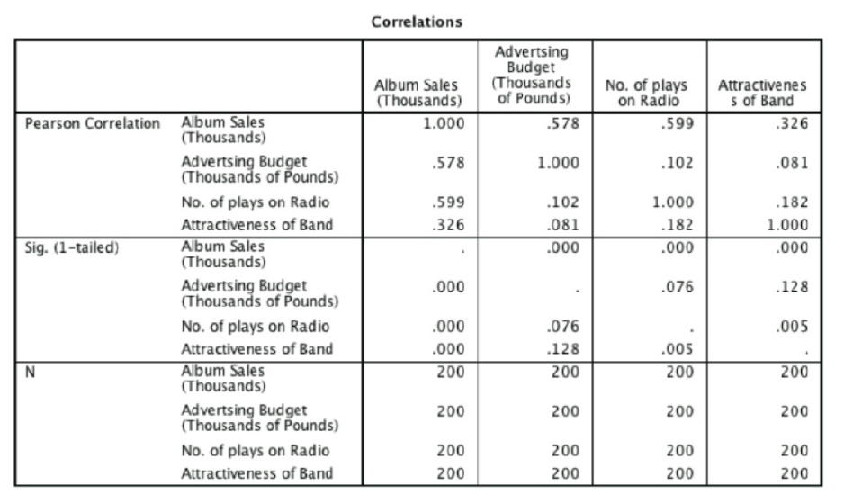
Correlation matrix
A correlation matrix is extremely useful for getting a rough idea of the relationships between predictors and the outcome, and for a preliminary look for multicollinearity
Use the descriptive statistics to check the correlation matrix for multicollinearity – that is, predictors that correlate too highly with each other, r > 0.8/0.9.
If we look only at the predictors (ignore album sales) then the highest correlation is between the attractiveness of the band and the amount of airplay, which is significant at a .01 level (r = .182, p = .005).

Slide 22
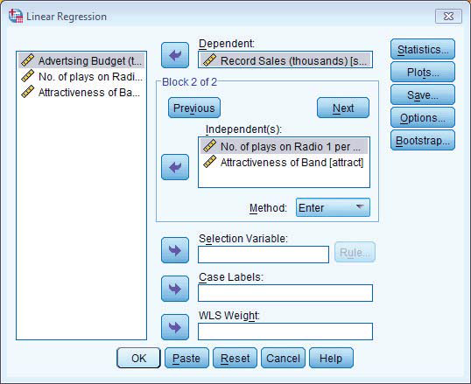
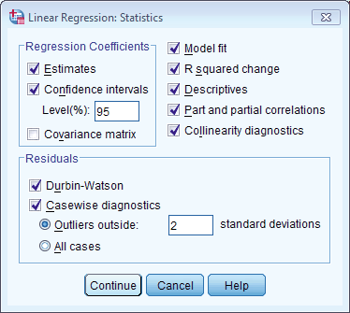
SPSS Inputs Multiple Regression
Model fit: This option is vital and so is selected by default. It provides not only a statistical test of the model’s ability to predict the outcome variable (the F-test), but also the value of R, the corresponding R² and the adjusted R²
Collinearity diagnostics: This option is for obtaining collinearity statistics such as the VIF and tolerance

Slide 23
SPSS Inputs Multiple Regression
Casewise diagnostics: This option, if selected, lists the observed value of the outcome, the predicted value of the outcome, the difference between these values (the residual) and this difference standardized.
It will list these values either for all cases, or just for cases for which the standardized residual is greater than 3 (when the ± sign is ignored). This criterion value of 3 can be changed.

Slide 24
Methods of Regression
Forced Entry:
All predictors are entered simultaneously.
Hierarchical:
Experimenter decides the order in which variables are entered into the model.
Stepwise:
Predictors are selected using their semi-partial correlation with the outcome.

Slide 25
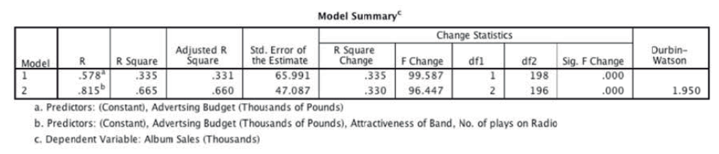
SPSS Output: Model Summary
R
The correlation between the observed values of the outcome, and the values predicted by the model.
R²
The proportion of variance accounted for by the model.
Adj. R²
An estimate of R² in the population (shrinkage).

Slide 26
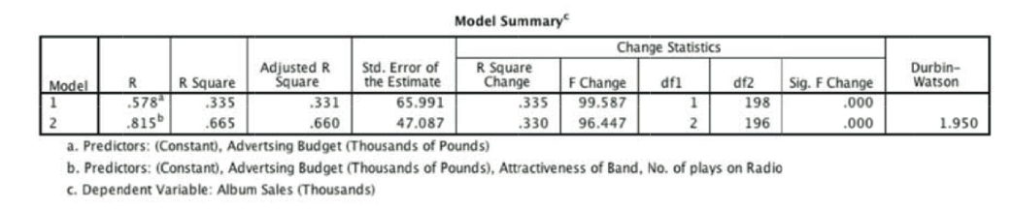
SPSS Output: Model Summary
R - When only advertising budget is used as a predictor, this is the simple correlation between advertising and album sales (.578).
The next column gives us a value of R², which is a measure of how much of the variability in the outcome is accounted for by the predictors.
For the first model its value is .335, which means that advertising budget accounts for 33.5% of the variation in album sales.
However, when the other two predictors are included as well (model 2), this value increases to .665 or 66.5% of the variance in album sales.

Slide 27
SPSS Output: Model Summary
The adjusted R² gives us some idea of how well our model generalizes.
We would like its value to be the same as, or very close to, the value of R².
In this example the difference for the final model is small This shrinkage means that if the model were derived from the population rather than a sample it would account for approximately 0.5% less variance in the outcome.

Slide 28
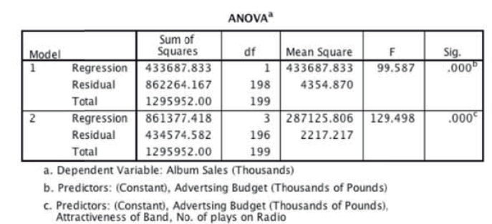
SPSS Output: ANOVA
The F-test
looks at whether the variance explained by the model (SS_{M}) is significantly greater than the error within the model (SS_{R}).
It tells us whether using the regression model is significantly better at predicting values of the outcome than using the mean.

Slide 29
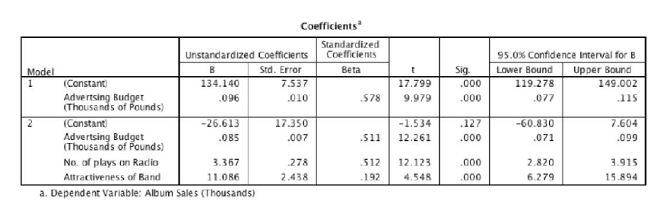
SPSS Output: Coefficients
The b-values tell us to what degree each predictor affects the outcome if the effects of all other predictors are held constant.
Standardised beta values:
tell us the same but expressed as standard deviations.
b₁= 0.085.
So, as advertising increases by £1, album sales increase by 0.085 thousand albums (85 albums)
b₂= 3.367.
So, each time (per week) a song is played on the radio its sales increase by 3.367 thousand albums.

Slide 30
Contribution of predictors to the model
Test statistics and their significance are produced for each regression coefficient: a t-test is used to see whether each b differs significantly from zero
If the t-test associated with a b-value is significant (if the value in the column labelled Sig. is less than .05) then the predictor is making a significant contribution to the model. The smaller the value of Sig. (and the larger the value of t), the greater the contribution

Slide 31
SPSS Output: Standardized values
The standardized versions of the b-values are probably easier to interpret (because they are not dependent on the units of measurement of the variables).
The standardized beta values tell us the number of standard deviations that the outcome will change as a result of one standard deviation change in the predictor.
e.g. As advertising increases by 1 standard deviation, album sales increase by 0.523 of a standard deviation.
The standardized beta values are all measured in standard deviation units and so are directly comparable: therefore, they provide a better insight into the ‘importance’ of a predictor in the model.

Slide 32
Standardised B Values
β₁= 0.523
As advertising increases by 1 standard deviation, album sales increase by 0.523 of a standard deviation.
β₂= 0.546
When the number of plays on the radio increases by 1 SD its sales increase by 0.546 standard deviations.
As advertising increases by £485,655, album sales increase by 0.523 × 80,699 = 42,206.
If the number of plays on the radio per week increases by 12, album sales increase by 0.546 × 80,699 = 44,062.

Slide 33
How well does the Model fit the data?
Some Ways to assess the accuracy of the model in the sample:
Standardised Residual Statistics
In an average sample, 95% of standardized residuals should lie between ± 2.
99% of standardized residuals should lie between ± 2.5.
Outliers
Any case for which the absolute value of the standardized residual is 3 or more, is likely to be an outlier.
Influential cases
Cook’s distance measures the influence of a single case on the model as a whole.
Absolute values greater than 1 may be cause for concern.
With a sample of 100 and three predictors, Mahalanobis distance values greater than 15 are problematic.

Slide 34
Generalising the Model
When we run regression, we hope to be able to generalize the sample model to the entire population.
To do this, several assumptions must be met.
Violating these assumptions stops us generalizing conclusions to our target population.

Slide 35
Assumptions of linear regression
Variable Type:
Outcome must be continuous
Predictors can be continuous or dichotomous.
Non-Zero Variance:
Predictors must not have zero variance

Slide 36
Assumptions of linear regression Correlation of Error Terms
An important assumption of the linear regression model is that the error terms, ε1,ε2,...,εn, are uncorrelated. If the errors are uncorrelated, then the fact that εi is positive provides little or no information about the sign of εi+1.
Such correlations frequently occur in the context of time series data, which consists of observations for which measurements are obtained at discrete points in time.
Correlation among the error terms can also occur outside of time series data. For instance, consider a study in which individuals’ heights are predicted from their weights. The assumption of uncorrelated errors could be violated if some of the individuals in the study are members of the same family, or eat the same diet

Slide 37
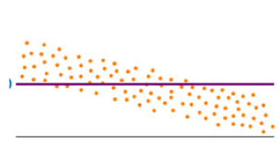
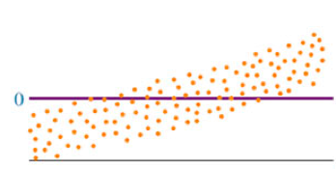
Residual Plots exhibiting Non-independent Error Terms
When successive residuals are correlated, we refer to this condition as autocorrelation, which frequently occurs when the data are collected over a period of time.
Note the run of residuals above the mean of the residuals, followed by a run below the mean (or vice versa). A scatter plot such as these would indicate possible autocorrelation.
Notes:
20

Slide 38
Assumptions - Linearity
Linearity:
The linear regression model assumes that there is a straight-line relationship between the predictors and the response. If the true relationship is far from linear, then virtually all of the conclusions that we draw from the fit are suspect. In addition, the prediction accuracy of the model can be significantly reduced.
If the residual plot indicates that there are non-linear associations in the data, then a simple approach is to use non-linear transformations of the predictors, such as logX, √X, and X², in the regression model.

Slide 39
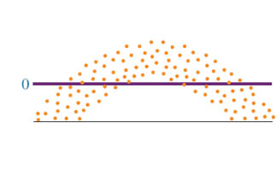
Non-linear Residual Plot
Notes:
18

Slide 40
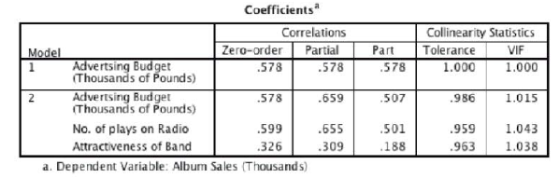
Assumptions of linear regression Collinearity / Multicollinearity
Collinearity refers to the situation in which two or more predictor variables are closely related to one another.
Collinearity reduces the accuracy of the estimates of the regression coefficients
Not all collinearity problems can be detected by inspection of the correlation matrix: it is possible for collinearity to exist between three or more variables even if no pair of variables has a particularly high correlation. We call this situation multicollinearity.
To check for multicollinearity, use the VIF values from the table labelled Coefficients in the SPSS output. If these values are less than 10, then there probably isn’t cause for concern. If you take the average of VIF values, and it is not substantially greater than 1, then there’s also no cause for concern.

Slide 41
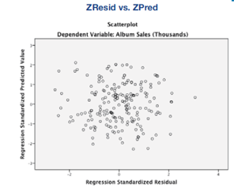
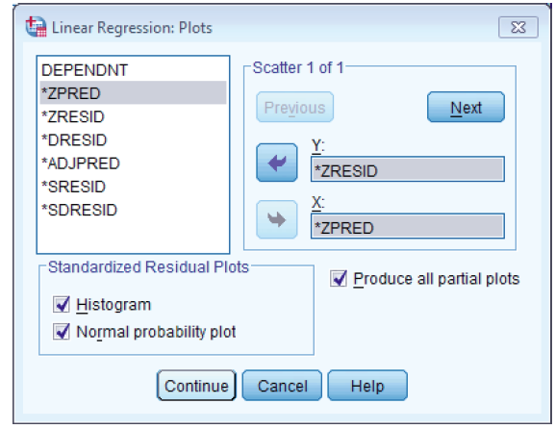
Assumptions of linear regression Homoscedasticity
For each value of the predictors the variance of the error term should be constant.
Homoscedasticity / Independence of Errors:
Plot ZRESID against ZPRED.

Slide 42
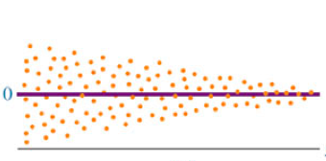
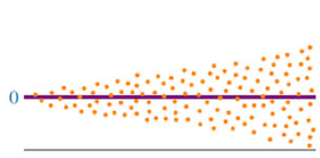
Residual Plots exhibiting Heteroscedacity
One can identify non-constant variances in the errors, or heteroscedasticity, from the presence of a funnel shape in the residual plot.
When faced with this problem, one possible solution is to transform the response Y using a concave function such as log Y or √Y .
Notes:
19

Slide 43
Independence of errors Durbin–Watson statistic
The Durbin–Watson statistic informs us about whether the assumption of independent errors is tenable.
As a conservative rule values less than 1 or greater than 3 would raise alarm bells
The closer to 2 that the value is, the better.

Slide 44
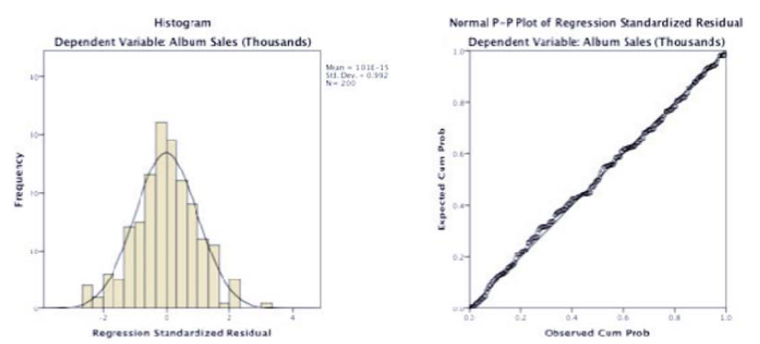
Assumptions of linear regression Normality of Errors:
Histogram of the standardized residuals (this is useful for checking the assumption of normality of errors). Second, you can ask for a Normal probability plot, which also provides information about whether the residuals in the model are normally distributed.

Slide 45
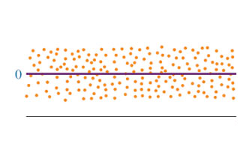
Healthy Residual Plot
Notes:
21

Slide 46
Reporting multiple regression
Report the coefficients, their confidence interval, significance value and some general statistics about the model (such as the R²).
The standardized values and the standard errors are also very useful.
For hierarchical regression you should report these values at each stage of the hierarchy. - you want to reproduce the table labelled Coefficients from the SPSS output and omit some of the non-essential information.

Slide 47
Types of Multiple Regression: Forced Entry Regression
All variables are entered into the model simultaneously.
The results obtained depend on the variables entered into the model.
It is important, therefore, to have good theoretical reasons for including a particular variable.

Slide 48
Types of Multiple Regression: Hierarchical Regression
Known predictors (based on past research) are entered into the regression model first.
New predictors are then entered in a separate step/block.
Experimenter makes the decisions.
It is the best method:
Based on theory testing.
You can see the unique predictive influence of a new variable on the outcome because known predictors are held constant in the model.
Bad Point:
Relies on the experimenter knowing what they’re doing!

Slide 49
Types of Multiple Regression: Stepwise Regression
Variables are entered into the model based on mathematical criteria.
Computer selects variables in steps.
Step 1
SPSS looks for the predictor that can explain the most variance in the outcome variable.
Step 2:
Having selected the 1st predictor, a second one is chosen from the remaining predictors.
The semi-partial correlation is used as a criterion for selection. It measures the unique contribution of a predictor to explaining the variance of the outcome.

Slide 51
Multiple Regression Analysis

